Slide 3
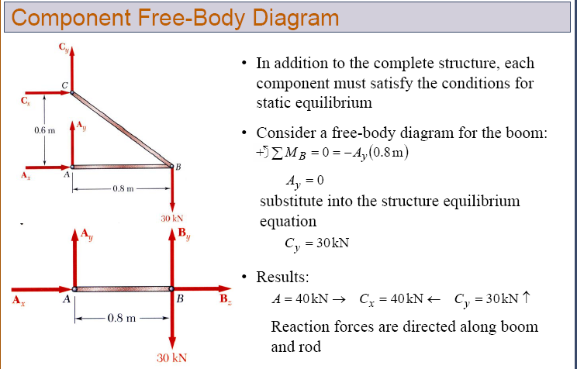

Slide 4
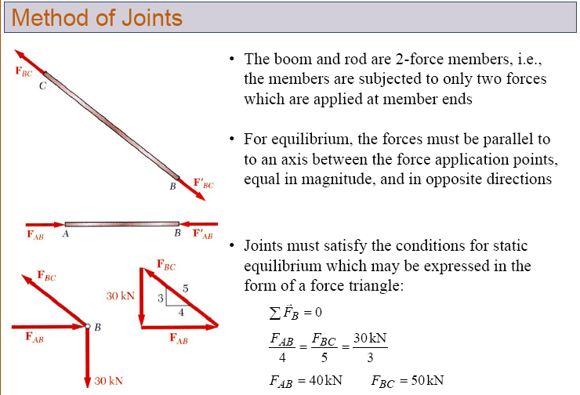

Slide 5
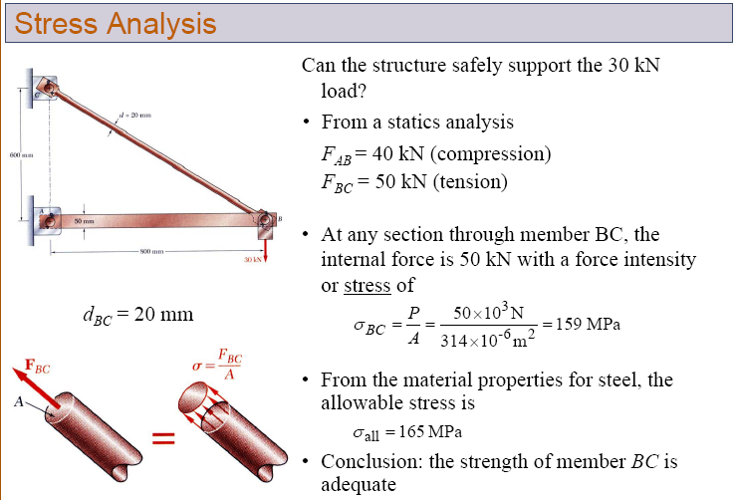

Slide 12
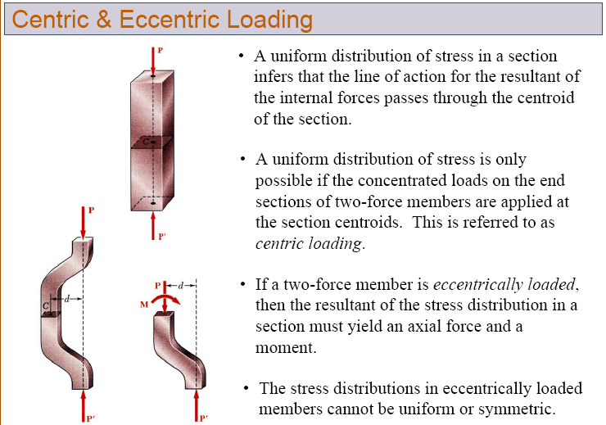

Slide 14
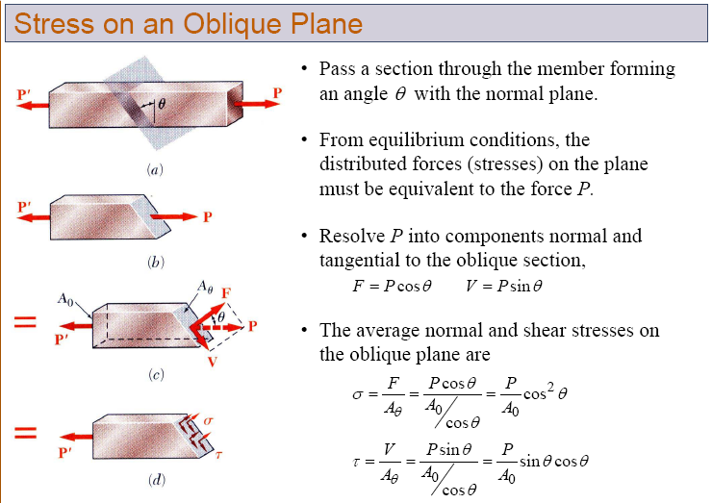

Slide 15
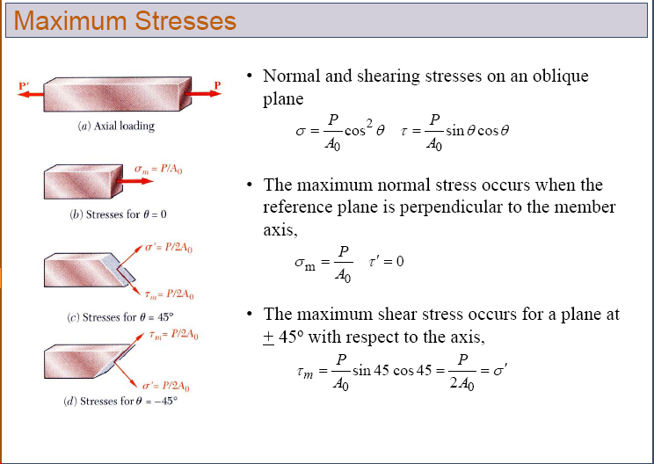

Slide 16
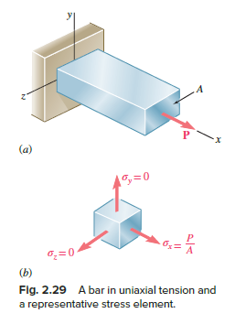
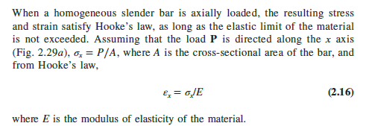
Poisson’s Ratio

Slide 17
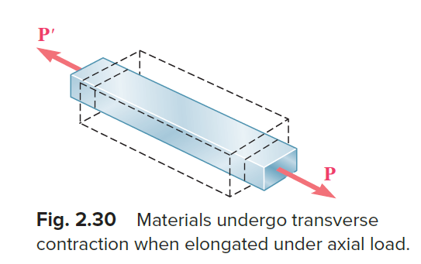
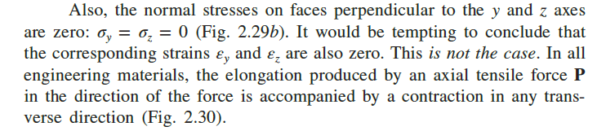
Poisson’s Ratio

Slide 18
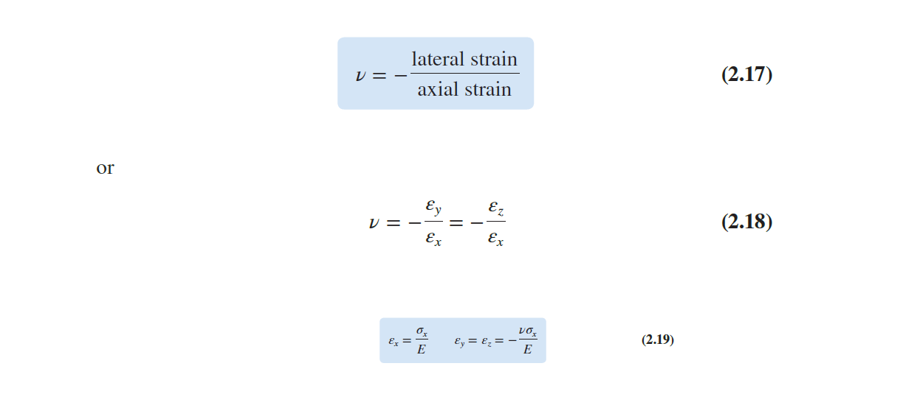
Poisson’s Ratio
The constant which relates lateral strain to axial strain is called Poisson’s ratio.

Slide 19
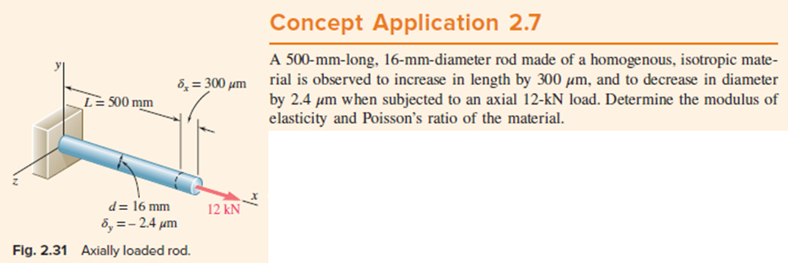

Slide 20
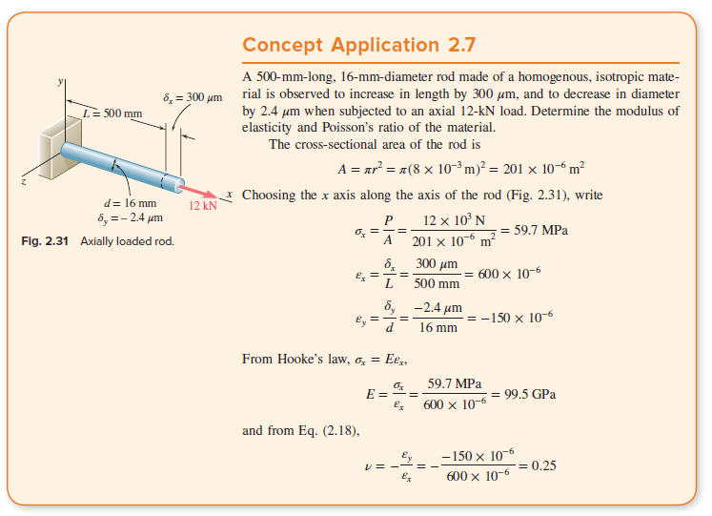

Slide 21
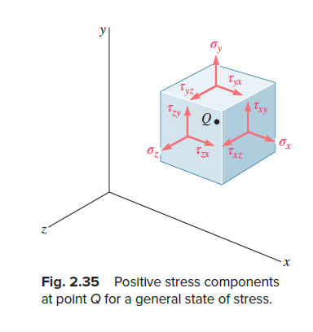
Shearing Strain
The shearing stress tend to deform a cubic element of material into an oblique parallelepiped.

Slide 22
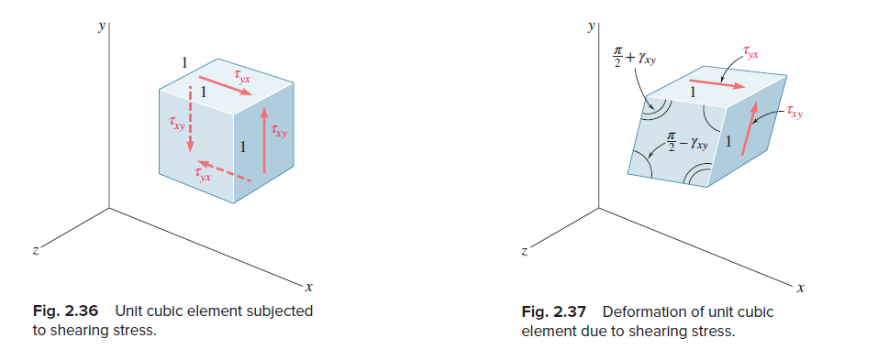
Shearing Strain

Slide 23
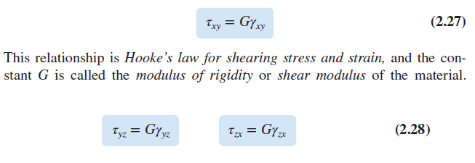
Shearing Strain

Slide 24
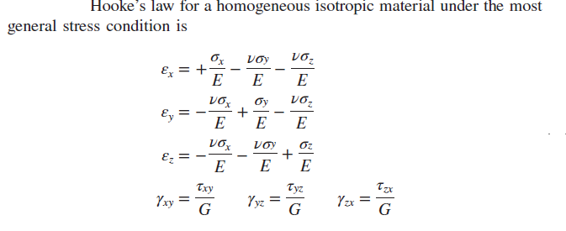
Shearing Strain

Slide 25
Residual Stresses
Consider a rod which is stretched beyond the yield point.
As the load gets removed, the rod did not regain its original length; it had been permanently deformed.
After the load was removed, all stresses disappeared
In actual complex structures, only some of the parts of structure undergo plastic deformations.
When different parts of the structure undergo different plastic deformations, the stresses in the various parts of the structure will not return to zero after the load has been removed.
These parts will be restrained from returning to a state of zero stress by the other parts that they are connected or bonded to.
Stresses called residual stresses will remain in various parts of the structure.

